Slide 1
Deep Residual Learning for Image Recognition
박은우

Slide 2
Abstract
Why “ResNet”?
To ease the training of networks that are deeper than those used previously.
Advantage
Easier to optimize, can gain accuracy from considerably increased depth.
Notes:
Deep할수록 학습 어렵다는 문제 인식-> 해결 위해 만들어짐.
이전의 방법들과 달리 residual 학습하는 방식으로 더 깊은 networks를 이전보다 더 쉽게 학습시키도록 만듬.

Slide 3
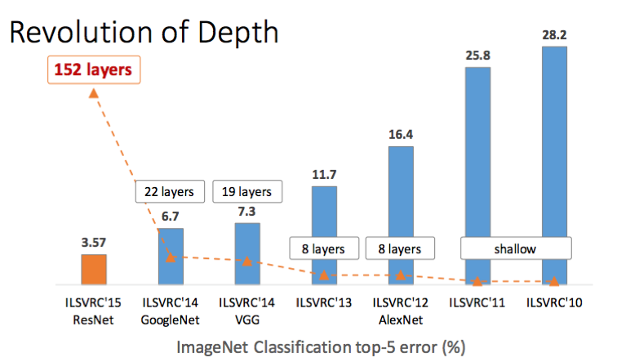

Slide 4
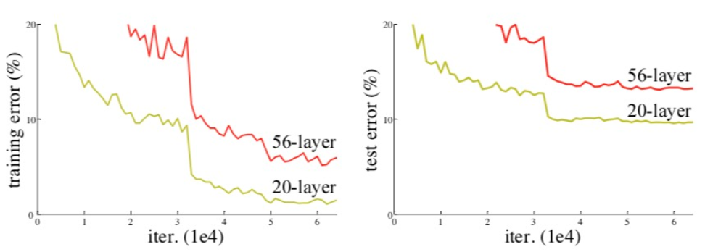
1. Introduction
Recent evidence reveals that network depth is of crucial importance.

Slide 5
But, is learning better networks as easy as stacking more layers?
vanishing/exploding gradients
hamper convergence from the beginning
solve the problem by normalized initialization & intermediate normalization layers
Degradation
Not by overfitting
adding more layers to a suitably deep model leads to higher training error
solve the problem by construction to the deeper model
: added layers are identity mapping, the other layers are copied from the learned shallower model

Slide 6
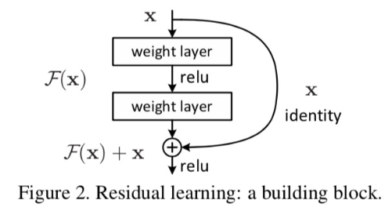
Address the degradation problem by introducing a deep residual learning framework
-extra para. X
-computational complexity ↑ x
H(x):=F(x)+x
출력과 입력 간 차에 대해 학습시키면
Degradation 해결 가능
F(x)=H(x)-x를 H(x)에 근사시키는 것이
이전 모델을 optimize하는 것보다 쉽다.

Slide 7
2. Related work
이전에는 multigrid method를 사용하였음
“highway networks” present shortcut connections with gating functions.
our identity shortcuts are never closed, and all info is always passed through.

Slide 8
3. Deep Residual Learning
3.1 Residual learning
Approximate the residual functions: H(x)-x (assuming that the input and output are of the same dimensions)
This reformulation is motivated by the counterintuitive phenomena about the degradation problem
상식: deeper, training error는 낮은 모델보다 더 낮을 수x

Slide 9



3.2 Identity Mapping by Shortcuts
ResNet은 layer가 적게 쌓여도 residual learning을 적용한다.
shortcut은 extra para가 필요x라는 것과 complexity 증가 x라는 것이 기존의 plain과 residual을 비교하는 데 매력적인 요소이다.
# X와 F는 차원이 같아야 함.
# 그렇지 않을 경우 linear projection. 차원을 맞추는 데만 이용

Slide 10
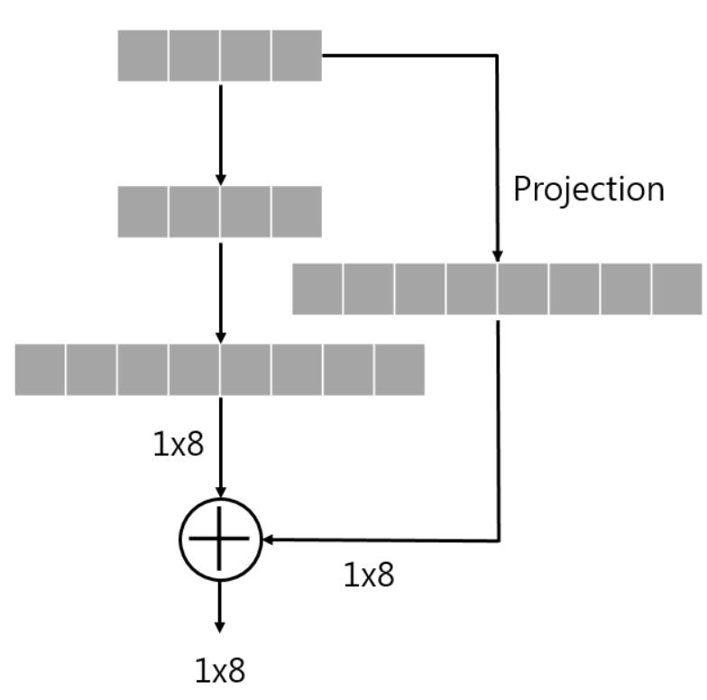
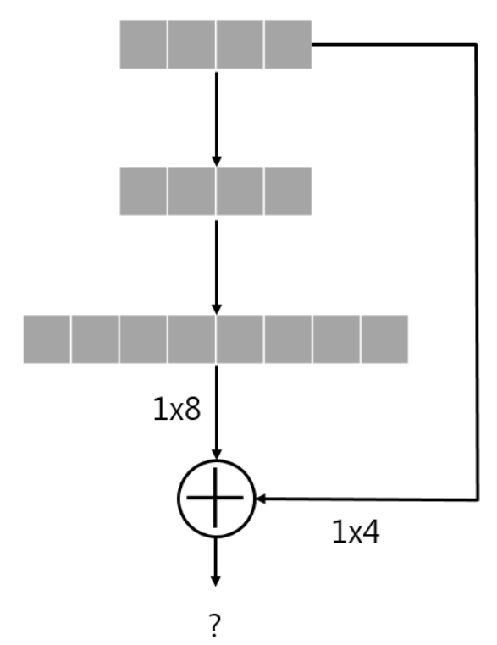

Slide 11
3.3 Network Architectures
1. plain network
그냥 layers를 쌓음. 대부분 3x3 filters를 가짐
같은 크기의 output feature map가지고 같은 수 filters 가짐
feature map size 반으로 줄면 time-complexity를 유지하기 위해 filters의 수 2배
VGG보다 filter 수 적고 complexity 낮음
2. residual network
plain에 기반하여 shortcut 추가한 버전.
input과 output 차원 동일하면 identity shortcut 바로 사용 가능
zero-padding
차원 맞추기 위해 1x1 convolution 사용
-> stride=2

Slide 12
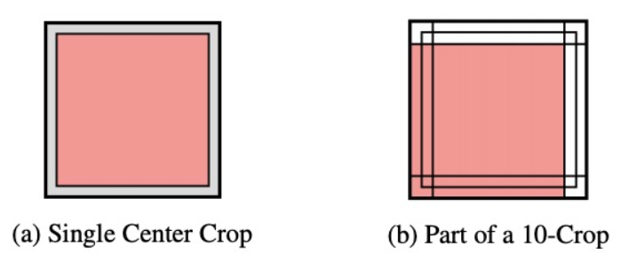
3.4 Implementation
[256,480] randomly sampled
batch normalization 적용
learning rate=0.1 (local min-> 1/10)
iter 60x10^4
weight decay=0.0001, momentum=0.9, dropout x
10-crop 사용

Slide 13
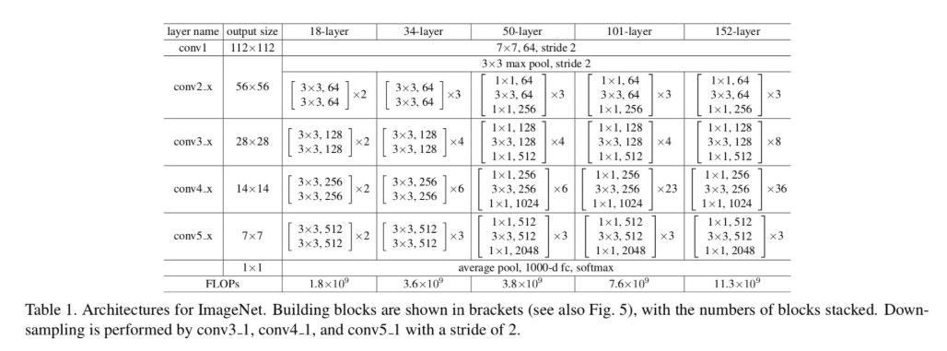
4. Experiments
4.1 ImageNet Classification

Slide 14
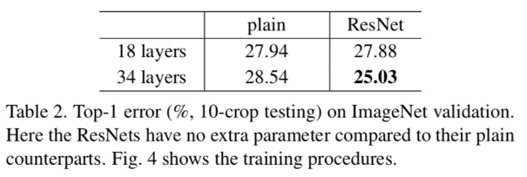
4.1.1 Plain Networks
18,34 layer, plain network

Slide 15
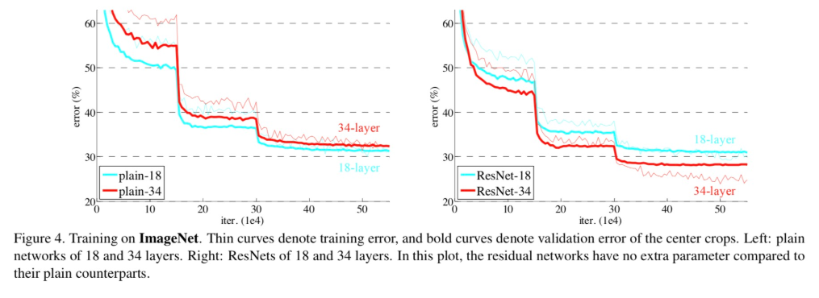
4.1.2 Residual networks

Slide 16
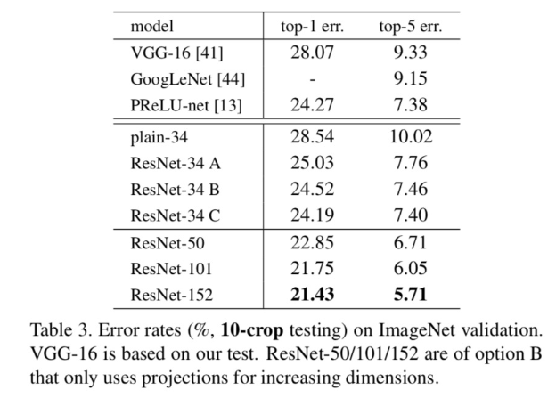
4.1.3 Identity vs projection shortcuts

Slide 17
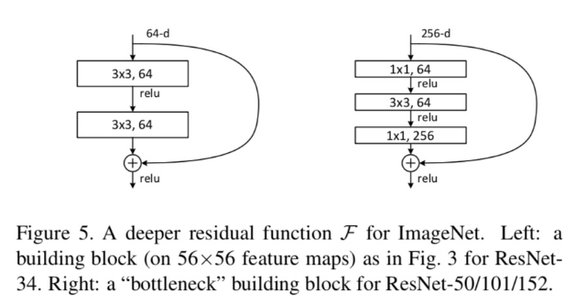
4.1.4 Deeper Bottlenect Architectures

Slide 18
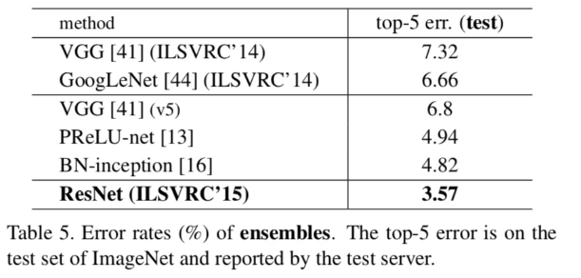
4.1.5 50-layers ResNet
3-layer bottlenect block을 차원 증가
4.1.6 101-layers and 152-layers ResNet
depth만 증가. 좋은 성능. Degradation x
4.1.7 Comparisons with State-of-the-art methods

Slide 19
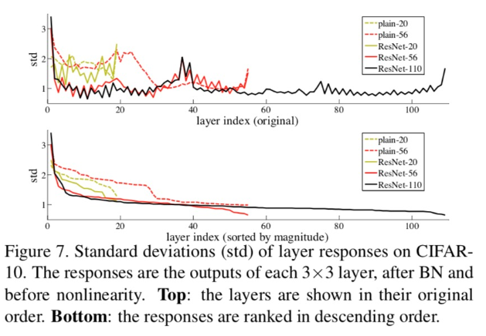
4.2.1 Analysis of layer Responses

Slide 20
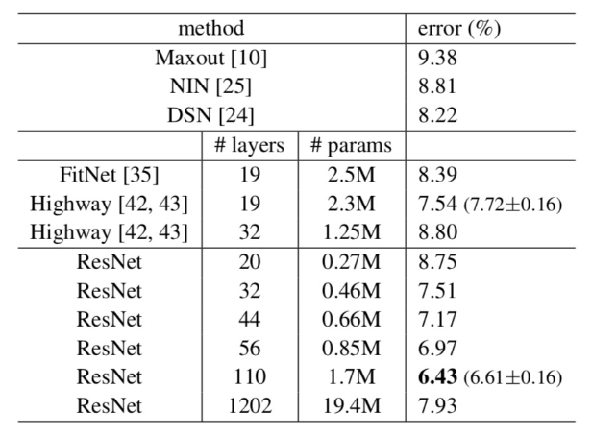
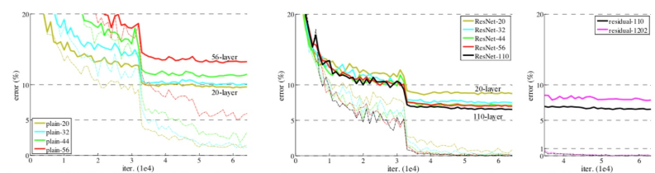
4.2.2 Exploring over 1000 layers

Slide 21
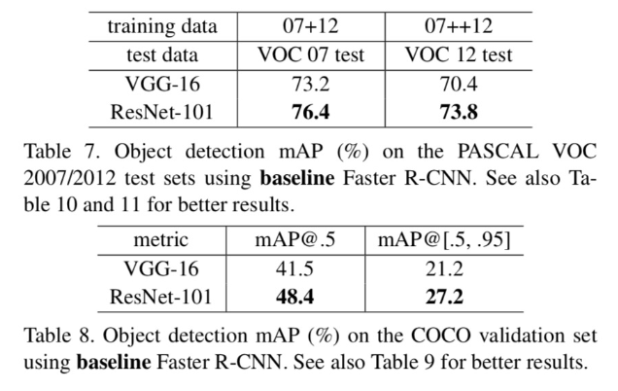
4.3 Object Detection on PASCAL and MS COCO

